Slide 1
Big Mountain Resort: New Evaluation of Ticket Prices
Data and Machine-learning Approach

Slide 2
Problem identification
Currently, Big Mountain Resort’s ticket price, $81, is a premium above market segment average
Problems:
This does not take into account Big Mountain Resort’s assets
Other resorts may have different ways of calculating evaluating their own ticket price
Therefore, Big Mountain may be losing money by charging less than they are able to given what Big Mountain can offer and what customers are looking for in a ski resort.

Slide 3
Key Findings &
Recommendations
Our analysis of over 270 ski resorts in the market segment recommends charging $96 for an adult weekend ticket, with an estimated error of about $10.
Following this, Big Mountain could be charging at least an additional $5 per ticket, and keep in line with what other resorts are charging based on their own assets. Independently, Big Mountain would need to charge an additional $0.88 per ticket to cover the operating costs of the newly installed chair lift.
We found that customers value vertical drop, the number of chair lifts, and guaranteed snow very much when choosing a resort.
Consequently, our analysis also showed scenario 2, increasing vertical drop by 150 ft., adding a run, and installing a new chair lift, to be the only scenario in which ticket prices were driven up. This is the scenario we recommend Big Mountain put into action.

Slide 4
Modeling Results
Analysis
Our best performing model was a random forest regressor, which identified the following as important features when determining ticket price:
the number of fast quads, the number of runs, snow making area, and vertical drop
This model estimated a ticket price for Big Mountain of $96±$10. A higher ticket price was expected because Big Mountain does indeed boast better statistics than most other resorts in its market segment, allowing for such a premium.

Slide 5
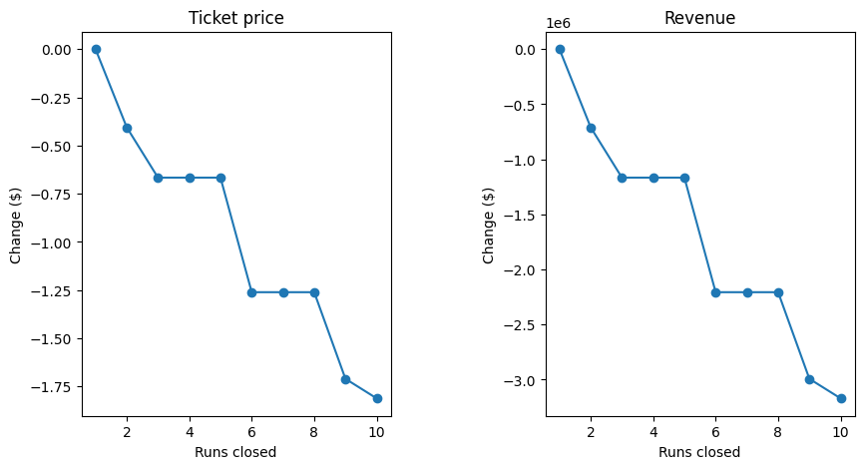
Modeling Results
Analysis
Scenario 1: Close up to 10 of the least used runs
Figure at right shows estimated change in ticket price as well as consequent change in revenue.
Model predicts drop in ticket price, and we therefore do not recommend this.
Scenario 4: Increase longest run by 0.2 miles for a total length of 3.5 miles, requires 4 additional acres of snow-making coverage.
Our analysis showed no change in ticket price by implementing this scenario, and we therefore do not recommend it as it would only incur additional costs and no foreseeable benefit.

Slide 6
Modeling Results
Analysis
Scenario 2: Increase vertical drop by 150 ft., add a run, add a chair lift
Our analysis showed that implementation of this scenario would increase estimated ticket price by $2, corresponding to an increase in revenue of $3.5M. Out of the 4 scenarios suggested, we recommend following this one.
Scenario 3: Same as scenario 2, but with an additional 2 acres of snow-making coverage
Our analysis showed the same $2 increase in estimated ticket price following the implementation of this scenario, indicating that the additional 2 acres of snow-making coverage did not have an effect on ticket price, and we therefore do not recommend it.

Slide 7
Summary
Conclusion
We analyzed over 270 ski resorts, built a model to evaluate ticket price, and explored future scenarios suggested by Big Mountain management.
We found that Big Mountain could be charging as much as $5 more per ticket.
The most lucrative scenario is the second one, increase vertical drop, add a run and a chair lift.
Implementing these changes would net Big Mountain Resort a much larger revenue stream which would in turn allow for more upgrades to the resort.

